Slide 1
IMM 120 / CSC 101
Welcome!

Slide 2
0. About the Class

Slide 3
My Name is Chris Hallberg
crhallberg@gmail.com
Office: Top of the stairs, right, end of the hall
Office Hours: 10am until class every Monday

Slide 4
About the Class
There is no textbook for the class
Make: Getting Started with p5.js
by Lauren McCarthy (creator of p5.js)
JavaScript: The Good Parts
by Douglas Crockford
The Nature of Code
by Daniel Shiffman (online)

Slide 5
About the Class
Important Links
GitHub: https://github.com/crhallberg/IMM120/tree/fall17
Codepen: https://cdpn.io/e/ZyrdYG

Slide 6
About the Class
There are 14 classes in this semester
Right now, 9 of them are instructional
2 are time for the midterm
2 are time for the final project

Slide 7
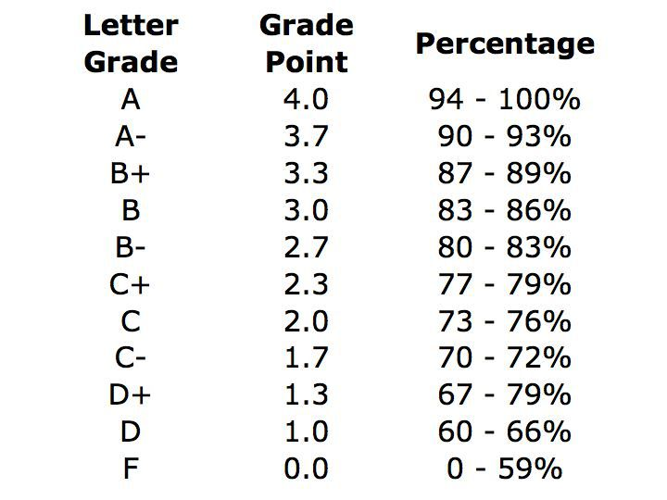
About the Class
Your final grade will consist of*:
15% for attendance
25% of all Homework
25% for your midterm project
35% for your final project

Slide 8
About the Class
Your final grade will consist of * :
15% for attendance
25% of all Homework
25% for your midterm project
35% for your final project

Slide 9
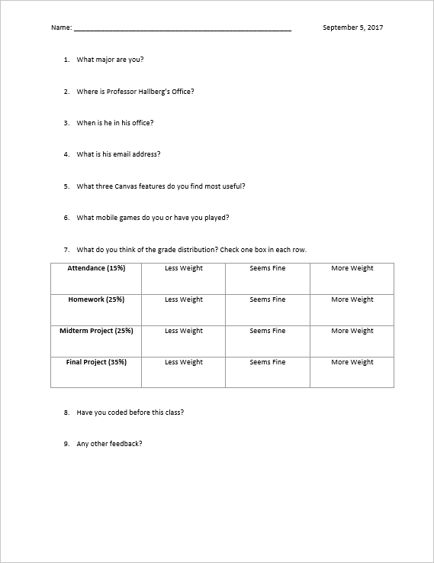
Minute Surveys

Slide 10
1. Learning to Program
"All programmers are playwrights and all computers are terrible actors.“
~ Anonymous

Slide 11
What it’s like to learn to program
Like learning a foreign language
Like learning a new way to think (algorithmically)
Learning a formal way of breaking down problems into steps

Slide 12
2. p5.js and Codepen
How we’re going to learn how to program

Slide 14
https://cdpn.io/e/ZyrdYG p5.js coding template

Slide 15
Questions?
Minute Surveys

